Slide 1
UNIT-IV
Memory and I/O Organization
Notes:
<number>

Slide 2
Syllabus Contents
Characteristics of Memory Systems, Internal and External Memory Types.
Memory Hierarchy, Principle Of Locality, Cache Memory – Basics, Performance Metrics & Improvements, Organization and Mapping Techniques, Handling Cache Misses & Writes, Replacement Algorithms, Multilevel Caches, Cache Coherence, Snooping & MESI Protocols,
Memory Segmentation & Interleaved Memory System.
Virtual Memory: Main Memory Allocation, Virtual to Physical Address Translation, Paging, Page Placement & Location, Page Faults, TLB in Address Translation, Handling TLB Misses & Page Faults.
Input / Output Systems, Programmed I/O, Interrupt Driven I/O, Direct Memory Access (DMA).

Slide 3
Characteristics of Memory systems
Notes:
<number>

Slide 4
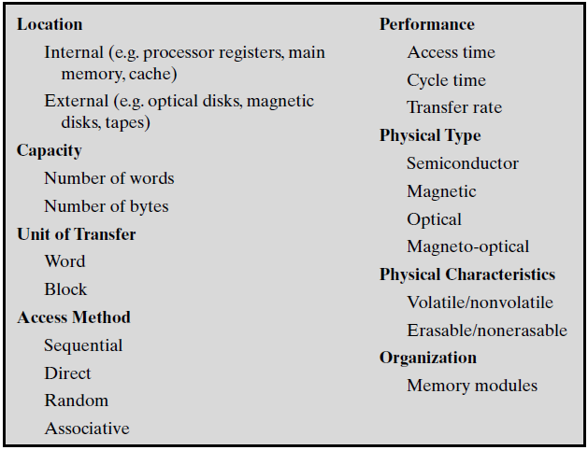
Characteristics of memory systems

Slide 5
Characteristics of memory systems (cont..)
Location
CPU/ Internal/ External
Capacity
Word size-The natural unit of organisation(8,16,32 bits)
Number of words or Bytes
Unit of transfer
Internal- Usually governed by data bus width
External
Usually a block which is much larger than a word
Addressable unit
Smallest location which can be uniquely addressed
Word internally
Blocks(much larger units than a word) for external memory
Notes:
<number>

Slide 6
Characteristics of memory systems (cont..) 4. Access Methods
Sequential
Start at the beginning and read through in order
Access time depends on location of data and previous location
e.g. tape
Direct
Individual blocks have unique address
Access is by jumping to vicinity plus sequential search
Access time depends on location and previous location
e.g. disk
Notes:
<number>

Slide 7
4. Access Methods (cont..)
Random
Individual addresses identify locations exactly
Access time is independent of location or previous access
e.g. RAM
Associative
Data is located by a comparison with contents of a portion of the store
Access time is independent of location or previous access
e.g. cache
Notes:
<number>

Slide 8
Characteristics of memory systems (cont..) 5. Performance
Access time
Time between presenting the address and getting the valid data
Memory Cycle time
Time may be required for the memory to “recover” before next access.
This additional time may be required for transients to die out on signal lines or to regenerate data if they are read destructively.
Cycle time is access + recovery
memory cycle time is concerned with the system bus, not the processor.
Transfer Rate
Rate at which data can be moved
Notes:
<number>

Slide 9
Characteristics of memory systems (cont..) 6. Physical Types
Semiconductor
RAM
Magnetic
Disk & Tape
Optical
CD & DVD
Others
Bubble
Hologram
Notes:
<number>

Slide 10
Characteristics of memory systems (cont..)
Physical Characteristics
Decay
Volatility
Erasable
Power consumption
Organisation
Physical arrangement of bits into words
Not always obvious
e.g. interleaved
Notes:
<number>

Slide 11
Memory Hierarchy
Registers- In CPU
Internal or Main memory
May include one or more levels of cache
“RAM”
External memory
Backing store
As one goes down the hierarchy, the following occur:
Decreasing cost per bit
Increasing capacity
Increasing access time
Decreasing frequency of access of the memory by the processor
Notes:
<number>

Slide 12
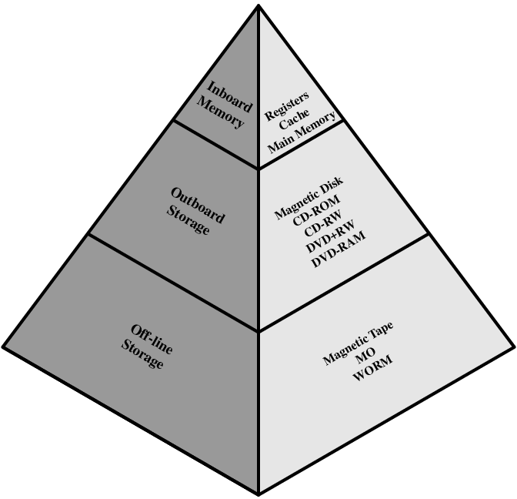
Memory Hierarchy - Diagram

Slide 13
Hierarchy List
Registers
L1 Cache
L2 Cache
Main memory
Disk cache
Disk
Optical
Tape
Notes:
<number>

Slide 14
Internal Memory
Notes:
<number>

Slide 15
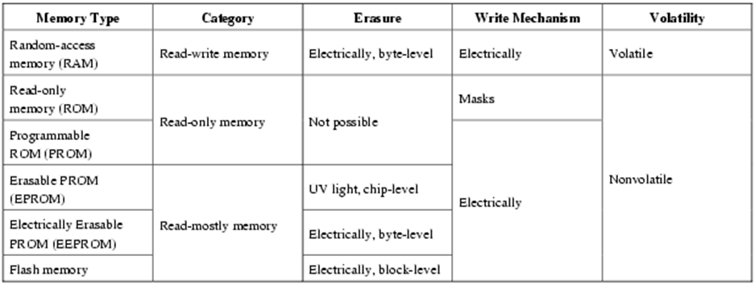
Semiconductor Memory Types

Slide 16
Semiconductor Memory
RAM
Misnamed as all semiconductor memory is random access
Read/Write
Volatile
If the power is interrupted, then the data are lost.
Temporary storage
The two basic forms of semiconductor random access memory are:
Dynamic RAM (DRAM)- It is slower, less expensive and denser. It is used for main memory.
Static RAM (SRAM)- It is faster, more expensive and less dense than DRAM, and is used for cache memory.
Notes:
<number>

Slide 17
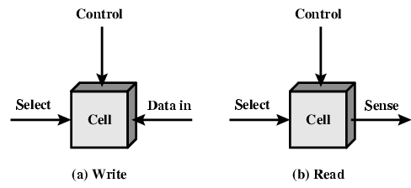
Memory Cell Operation

Slide 18
Dynamic RAM
Bits stored as charge on capacitors
Charges leak
Need refreshing even when powered
Need refresh circuits
Simpler construction
Smaller per bit
Less expensive
Slower
Main memory
Essentially analog
Level of charge determines value
Notes:
<number>

Slide 19
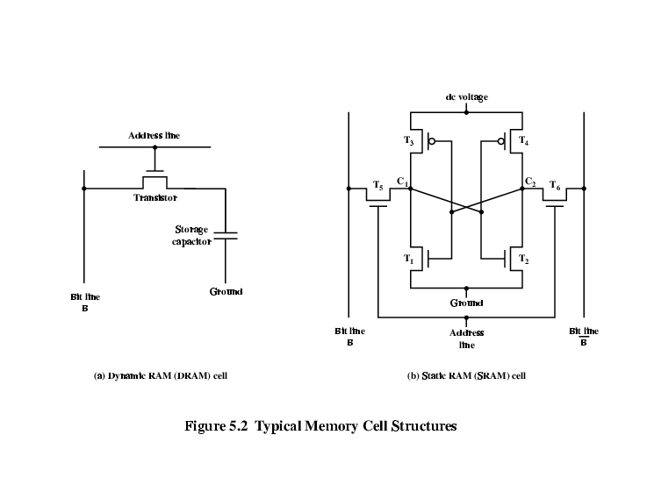
Dynamic RAM Structure

Slide 20
DRAM Operation
Address line active when bit read or written
Transistor switch closed (current flows)
Write
Voltage to bit line
High for 1 low for 0
Then signal address line
Transfers charge to capacitor
Read
Address line selected
transistor turns on
Charge from capacitor fed via bit line to sense amplifier
Compares with reference value to determine 0 or 1
Capacitor charge must be restored

Slide 21
Static RAM
Bits stored as on/off switches
No charges to leak
No refreshing needed when powered
Does not need refresh circuits
More complex construction
Larger per bit
More expensive
Faster
Cache
Digital
Uses flip-flops
Notes:
<number>

Slide 22
Stating RAM Structure

Slide 23
Static RAM Operation
Transistor arrangement gives stable logic state
State 1
C_{1 high, C2 low}
_{T1 T4 off, T2 T3 on}
_{State 0}
_{C2 high, C1 low}
_{T2 T3 off, T1 T4 on}
Address line transistors T5 T6 is switch
Write – apply value to B & compliment to B
_{Read – value is on line B}

Slide 24
SRAM v DRAM
Both volatile
Power needed to preserve data
Dynamic cell
Simpler to build, smaller
Denser than SRAM (smaller cells= more cells per unit area)
Less expensive
Needs refreshing circuit
Used for Larger memory units
Static
Faster
Used for Cache

Slide 25
Read Only Memory (ROM)
Permanent storage that cannot be changed
Nonvolatile
Possible to read a ROM, it is not possible to write new data into it.
Application of ROMs :
Microprogramming
Library subroutines for frequently wanted functions
Systems programs (BIOS)
Function tables
Advantage:
For a modest-sized requirement, the data or program is permanently in main memory and need never be loaded from a secondary storage device.
Notes:
<number>

Slide 26
Types of ROM
Written during manufacture
Very expensive for small runs
Programmable (once)-PROM
the writing process is performed electrically and may be performed by a supplier or customer at a time later than the original chip fabrication.
Needs special equipment to program
Read “mostly”
Erasable Programmable (EPROM)- Erased by UV
Electrically Erasable (EEPROM) - Takes much longer to write than read
Flash memory- Erase whole memory electrically
Notes:
<number>

Slide 27
Erasable Programmable Read-Only Memory (EPROM)
It is read and written electrically, as with PROM.
However, before a write operation, all the storage cells must be erased to the same initial state by exposure of the packaged chip to ultraviolet radiation.
This erasure process can be performed repeatedly; each erasure can take as much as 20 minutes to perform.
It can be altered multiple times and, like the ROM and PROM, holds its data virtually indefinitely.
For comparable amounts of storage, the EPROM is more expensive than PROM, but it has the advantage of the multiple update capability.

Slide 28
Electrically Erasable Programmable Read-Only Memory (EEPROM)
It is a read-mostly memory that can be written into at any time without erasing prior contents; only the byte or bytes addressed are updated.
The write operation takes considerably longer than the read operation, on the order of several hundred microseconds per byte.
It combines the advantage of nonvolatility with the flexibility of being updatable in place, using ordinary bus control, address, and data lines.
EEPROM is more expensive than EPROM and also is less dense, supporting fewer bits per chip.

Slide 29
Flash Memory
It is so named because of the speed with which it can be reprogrammed.
It is intermediate between EPROM and EEPROM in both cost and functionality.
Like EEPROM, it uses an electrical erasing technology.
An entire flash memory can be erased in one or a few seconds, which is much faster than EPROM.
In addition, it is possible to erase just blocks of memory rather than an entire chip.
However, it does not provide byte-level erasure. Like EPROM.
It uses only one transistor per bit, and so achieves the high density (compared with EEPROM) of EPROM.

Slide 30
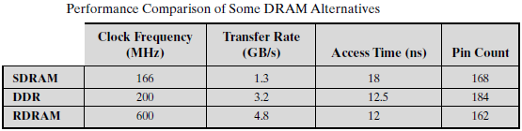
Advanced DRAM Organization
It is needed to compensate for the relatively slow speed of DRAM.
A number of enhancements to the basic DRAM architecture:
SDRAM (Synchronous DRAM)
DDR-SDRAM (Double Data Rate DRAM)
RDRAM (Rambus DRAM)
Notes:
<number>

Slide 31
Synchronous DRAM (SDRAM)
Unlike the traditional DRAM, which is asynchronous, the SDRAM exchanges data with the processor synchronized to an external clock signal.
Operation Mechanism:
Address is presented to RAM
RAM finds data (CPU waits in conventional DRAM)
Since SDRAM moves data in time with system clock, CPU knows when data will be ready
CPU does not have to wait, it can do something else.
Notes:
<number>

Slide 32
SDRAM (cont..)
Burst Mode:
Burst mode allows SDRAM to set up stream of data and fire it out in block.
Burst mode is useful when all the bits to be accessed are in sequence and in the same row of the array as the initial access.
The mode register and associated control logic:
The mode register specifies the burst length, which is the number of separate units of data synchronously fed onto the bus.
The register also allows the programmer to adjust the latency between receipt of a read request and the beginning of data transfer.

Slide 33
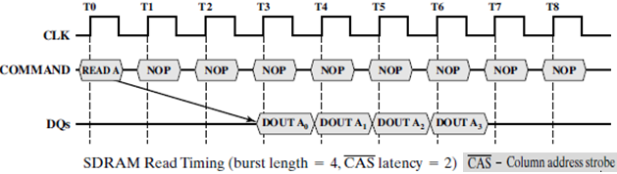
SDRAM (cont..)
The SDRAM performs best when it is transferring large blocks of data serially, such as for applications like word processing, spreadsheets, and multimedia.
The SDRAM has a multiple-bank internal architecture that improves opportunities for on-chip parallelism.

Slide 34
Double Data Rate DRAM (DDR-DRAM)
SDRAM is limited by the fact that it can only send data to the processor once per bus clock cycle.
A new version of SDRAM, referred to as Double-Data-Rate SDRAM can send data twice per clock cycle, once on the rising edge of the clock pulse and once on the falling edge.
It is also synchronized to a bidirectional data strobe (DQS) signal that is provided by the memory controller during a read and by the DRAM during a write.

Slide 35
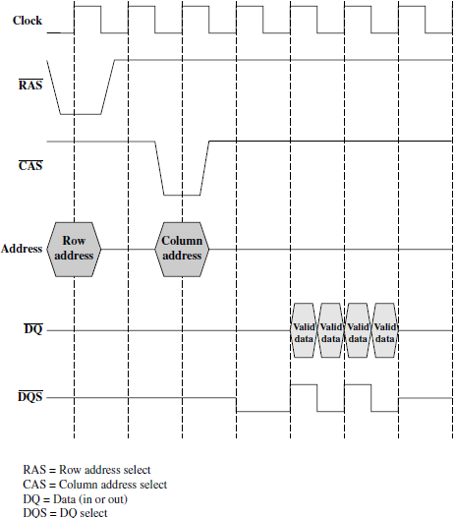
DDR-DRAM Read Timing

Slide 36
RAMBUS DRAM
Adopted by Intel for Pentium & Itanium
Main competitor to SDRAM
Vertical package – all pins on one side
Data exchange over 28 wires < 12cm long
Bus addresses up to 320 RDRAM chips & rated at 1.6Gbps
Asynchronous block protocol
Initial 480ns access time then 1.6 Gbps data rate
Notes:
<number>

Slide 37
RDRAM(cont..)
An RDRAM gets a memory request over the high-speed bus.
This request contains the desired address, the type of operation, and the number of bytes in the operation.
No need of the explicit control signals RAS, CAS, R/W, CE as those are used in conventional DRAMs.
18 data lines (16 actual data, 2 parity) cycling at twice the clock rate
i.e. 1 bit is sent at the leading and following edge of each clock signal.
This results in a signal rate on each data line of 800 Mbps.

Slide 38
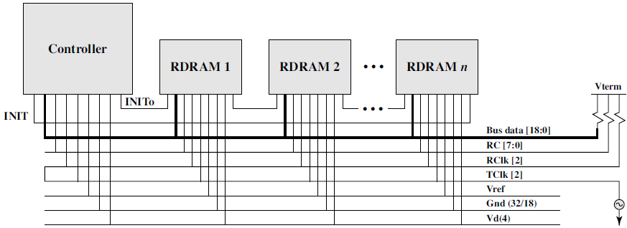
RAMBUS DRAM Diagram

Slide 39
EXTERNAL Memory (secondary storage)
Notes:
<number>

Slide 40
Types of External Memory
Magnetic Disk
RAID
Removable
Optical
CD-ROM
CD-Recordable (CD-R)
CD-R/W
DVD
Magnetic Tape
Notes:
<number>

Slide 41
Magnetic Disk
Disk substrate coated with magnetizable material (iron oxide…rust)
Substrate used to be aluminium
Now glass
Improved surface uniformity
Increases reliability
Reduction in surface defects
Reduced read/write errors
Lower flight heights (See later)
Better stiffness
Better shock/damage resistance
Notes:
<number>

Slide 42
Read and Write Mechanisms
Recording and retrieval via conductive coil called a head
May be single read/write head or separate ones
During read/write, head is stationary, platter rotates
Write
Current through coil produces magnetic field
Pulses sent to head
Magnetic pattern recorded on surface below
Read (traditional)
Magnetic field moving relative to coil produces current
Coil is the same for read and write
Read (contemporary)
Separate read head, close to write head
Partially shielded magneto resistive (MR) sensor
Electrical resistance depends on direction of magnetic field
High frequency operation- Higher storage density and speed

Slide 43
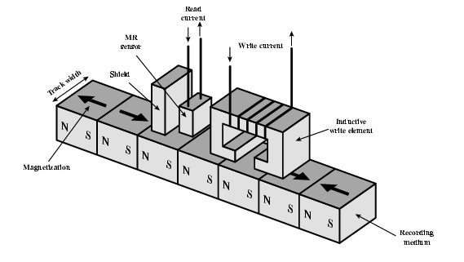
Inductive Write MR Read

Slide 44
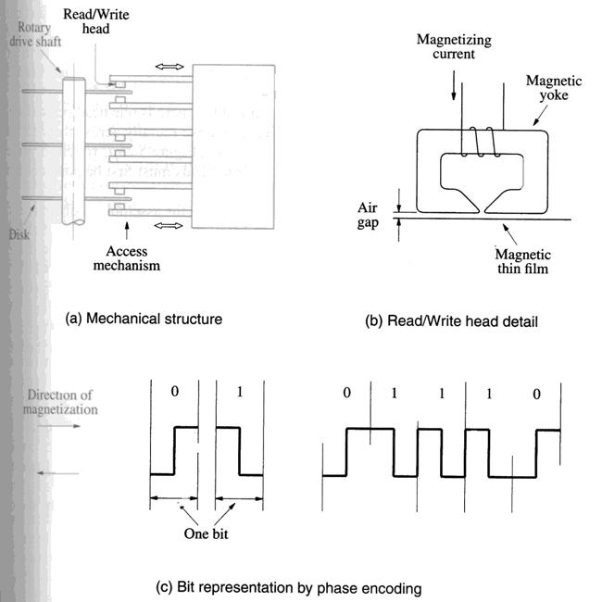
Magnetic Hard Disks
Disk
Disk drive
Disk controller
Notes:
<number>

Slide 45
Data Organization and Formatting
Concentric rings or tracks
Gaps between tracks
Reduce gap to increase capacity
Same number of bits per track (variable packing density)
Constant angular velocity
Tracks divided into sectors
Minimum block size is one sector
May have more than one sector per block
Notes:
<number>

Slide 46
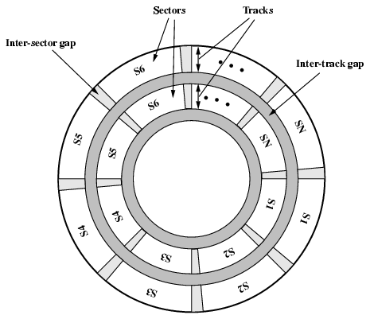
Disk Data Layout
Notes:
<number>

Slide 47
Disk Velocity
Bit near centre of rotating disk passes fixed point slower than bit on outside of disk
Increase spacing between bits in different tracks
Rotate disk at constant angular velocity (CAV)
Gives pie shaped sectors and concentric tracks
Individual tracks and sectors addressable
Move head to given track and wait for given sector
Waste of space on outer tracks
Lower data density
Can use zones to increase capacity
Each zone has fixed bits per track
More complex circuitry

Slide 48
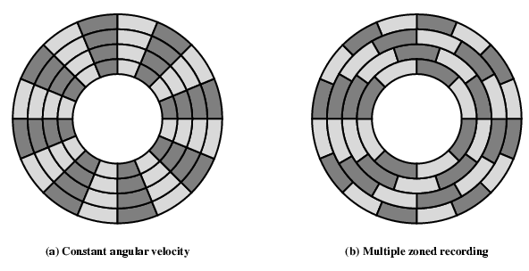
Disk Layout Methods Diagram

Slide 49
RAID
Development of arrays of disks that operate independently and in parallel.
With multiple disks, separate I/O requests can be handled in parallel, as long as the data required reside on separate disks.
a single I/O request can be executed in parallel if the block of data to be accessed is distributed across multiple disks.
With the use of multiple disks, there is a wide variety of ways in which the data can be organized and in which redundancy can be added to improve reliability
A standardized scheme for multiple-disk database design, known as RAID.
Notes:
<number>

Slide 50
RAID (cont..)
Redundant Array of Independent Disks
Redundant Array of Inexpensive Disks (*few references)
Seven levels-zero through six.
These levels do not imply a hierarchical relationship but designate different design architectures
Share three common characteristics:
RAID is a set of physical disk drives viewed by the operating system as a single logical drive.
Data are distributed across the physical drives of an array in a scheme known as striping.
Redundant disk capacity is used to store parity information, which guarantees data recoverability in case of a disk failure. (*not in RAID0 & RAID1)

Slide 51
RAID 0
No redundancy
Data striped across all disks
Round Robin striping
Increase speed
Multiple data requests probably not on same disk
Disks seek in parallel
A set of data is likely to be striped across multiple disks
Notes:
<number>

Slide 52
RAID 1
Mirrored Disks
Data is striped across disks
2 copies of each stripe on separate disks
Read from either
Write to both
Recovery is simple
Swap faulty disk & re-mirror
No down time
Expensive
Notes:
<number>

Slide 53
RAID 2
Disks are synchronized
Very small stripes
Often single byte/word
Error correction calculated across corresponding bits on disks
Multiple parity disks store Hamming code error correction in corresponding positions
Lots of redundancy
Expensive
Not used
Notes:
<number>

Slide 54
RAID 3
Similar to RAID 2
Only one redundant disk, no matter how large the array
Simple parity bit for each set of corresponding bits
Data on failed drive can be reconstructed from surviving data and parity info
Very high transfer rates
Notes:
<number>

Slide 55
RAID 4
Each disk operates independently
Good for high I/O request rate
Large stripes
Bit by bit parity calculated across stripes on each disk
Parity stored on parity disk
Notes:
<number>

Slide 56
RAID 5
Like RAID 4
Parity striped across all disks
Round robin allocation for parity stripe
Avoids RAID 4 bottleneck at parity disk
Commonly used in network servers
Notes:
<number>

Slide 57
RAID 6
Two parity calculations
Stored in separate blocks on different disks
User requirement of N disks needs N+2
High data availability
Three disks need to fail for data loss
Significant write penalty

Slide 58
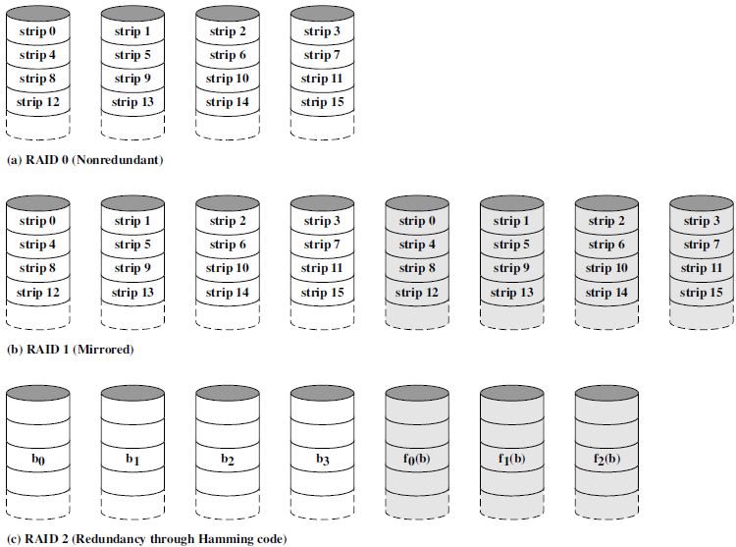
RAID 0, 1, 2

Slide 59
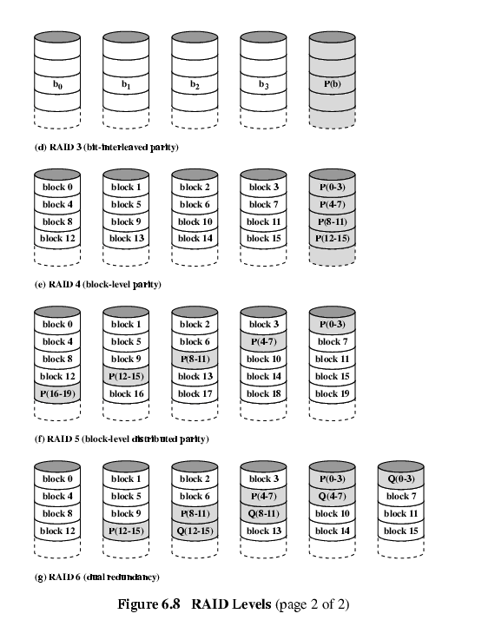
RAID 3 & 4

Slide 60
RAID 5 & 6

Slide 61
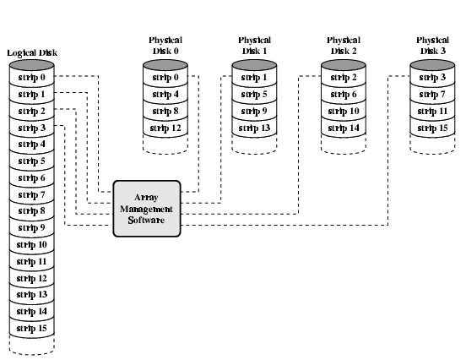
Data Mapping For RAID 0

Slide 62
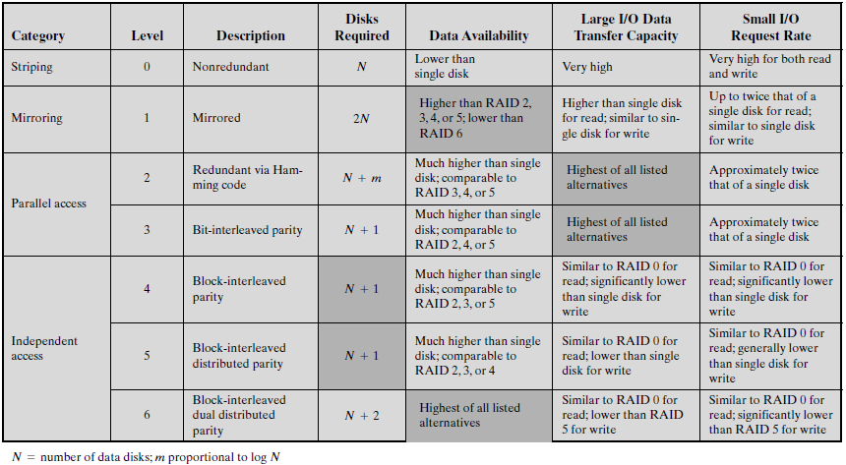

Slide 63
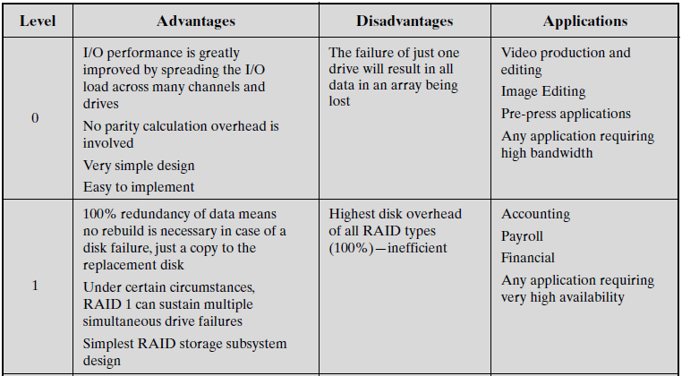
RAID Comparison

Slide 64
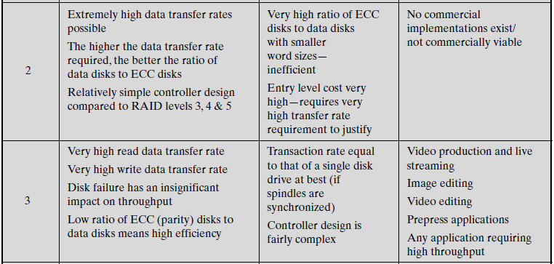
RAID Comparison (cont..)

Slide 65
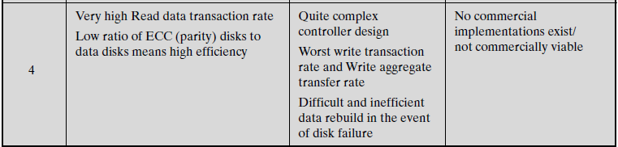
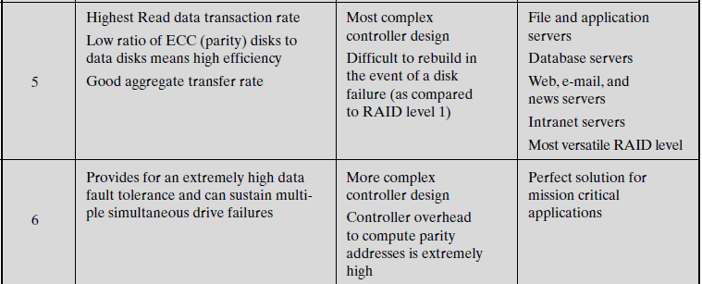
RAID Comparison (cont..)

Slide 66
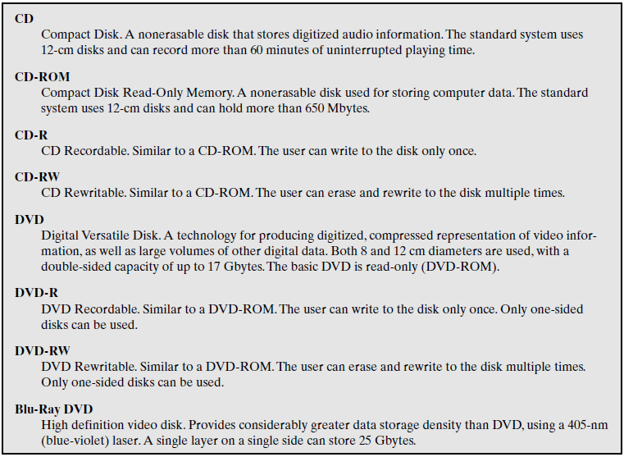
Optical Disk Products

Slide 67
Optical Storage CD-ROM
Originally for audio
650Mbytes giving over 70 minutes audio
Polycarbonate coated with highly reflective coat, usually aluminium
Data stored as pits
Read by reflecting laser
Constant packing density
Constant linear velocity
Notes:
<number>

Slide 68
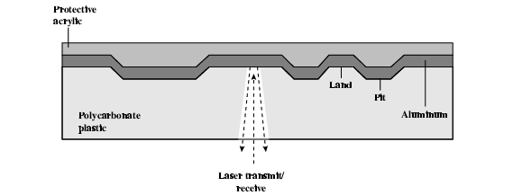
CD Operation

Slide 69
CD-ROM Drive Speeds
Audio is single speed
Constant linier velocity
1.2 ms⁻¹
^{Track (spiral) is 5.27km long}
Gives 4391 seconds = 73.2 minutes
Other speeds are quoted as multiples
^{e.g. 24x}
Quoted figure is maximum drive can achieve
Notes:
<number>

Slide 70
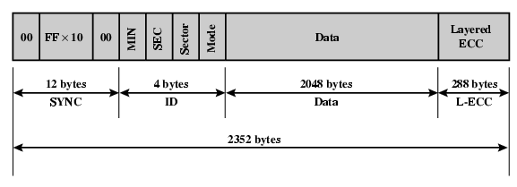
CD-ROM Format
Mode 0=blank data field
Mode 1=2048 byte data+error correction
Mode 2=2336 byte data
Notes:
<number>

Slide 71
Random Access on CD-ROM
Difficult
Move head to rough position
Set correct speed
Read address
Adjust to required location
(Yawn!)
Notes:
<number>

Slide 72
CD-ROM for & against
Large capacity (?)
Easy to mass produce
Removable
Robust
Expensive for small runs
Slow
Read only
Notes:
<number>

Slide 73
Other Optical Storage
CD-Recordable (CD-R)
WORM
Now affordable
Compatible with CD-ROM drives
CD-RW
Erasable
Getting cheaper
Mostly CD-ROM drive compatible
Phase change
Material has two different reflectivities in different phase states
Notes:
<number>

Slide 74
DVD - what’s in a name?
Digital Video Disk
Used to indicate a player for movies
Only plays video disks
Digital Versatile Disk
Used to indicate a computer drive
Will read computer disks and play video disks
Dogs Veritable Dinner
Officially - nothing!!!
Notes:
<number>

Slide 75
DVD - technology
Multi-layer
Very high capacity (4.7G per layer)
Full length movie on single disk
Using MPEG compression
Finally standardized (honest!)
Movies carry regional coding
Players only play correct region films
Can be “fixed”
Notes:
<number>

Slide 76
DVD – Writable
Loads of trouble with standards
First generation DVD drives may not read first generation DVD-W disks
First generation DVD drives may not read CD-RW disks
Wait for it to settle down before buying!
Notes:
<number>

Slide 77
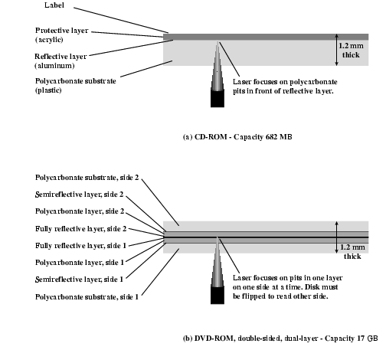
CD and DVD

Slide 78
Magnetic Tape
Serial access
Slow
Very cheap
Backup and archive
Notes:
<number>

Slide 79
Digital Audio Tape (DAT)
Uses rotating head (like video)
High capacity on small tape
4Gbyte uncompressed
8Gbyte compressed
Backup of PC/network servers
Notes:
<number>

Slide 80
cache Memory (High speed memory)
Notes:
<number>

Slide 81
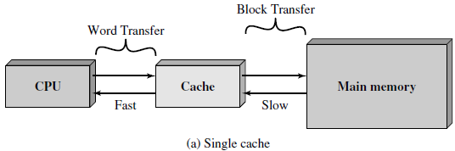
Cache Memory
Small amount of fast memory
Sits between normal main memory and CPU
May be located on CPU chip or module
The cache contains a copy of portions of main memory.
Notes:
<number>

Slide 82
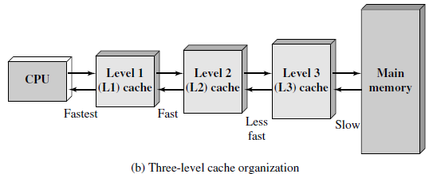
Cache Memory (cont..)
Because of the phenomenon of locality of reference, when a block of data is fetched into the cache to satisfy a single memory reference, it is likely that there will be future references to that same memory location or to other words in the block.

Slide 83
Locality of Reference
Spatial locality:
It refers to the tendency of execution to involve a number of memory locations that are clustered.
This reflects the tendency of a processor to access instructions sequentially.
Spatial location also reflects the tendency of a program to access data locations sequentially, such as when processing a table of data.
Spatial locality is generally exploited by using larger cache blocks and by incorporating prefetching mechanisms (fetching items of anticipated use) into the cache control logic.

Slide 84
Locality of Reference (cont..)
Spatial locality: e.g. Miss for 1st word but for next words in that block, there will be hit as entire block is copied in the cache. Hit ratio=2/3.
t=a
a=b
b=t
Block
2
t=a
a=b
b=t
Process
1
3
Cache
Miss
Hit
Main Memory

Slide 85
Locality of Reference (cont..)
Temporal locality:
It refers to the tendency for a processor to access memory locations that have been used recently.
Traditionally, temporal locality is exploited by keeping recently used instruction and data values in cache memory and by exploiting a cache hierarchy.
e.g. when an iteration loop is executed, the processor executes the same set of instructions repeatedly.
for (i=1;i≤100;i++)
for i=1 -------------- miss
i=2 to 100 --------- hit Hit ratio=99/100

Slide 86
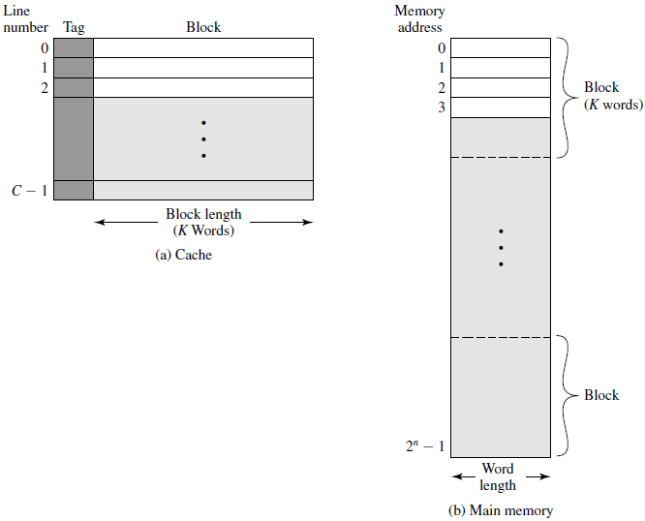
Cache/ Main Memory Structure

Slide 87
Cache/ Main Memory Structure (cont..)
Main memory:
consists of up to 2n addressable words, with each word having a unique n-bit address.
For mapping purposes, this memory is considered to consist of a number of fixed length blocks of K words each.
That is, there are M= 2n / K blocks in main memory.
^{Cache Memory:}
consists of m blocks, called lines.
Each line contains K words + tag bits (to identify which particular block is currently being stored) + control bits such as a bit to indicate whether the line has been modified since being loaded into the cache

Slide 88
Cache/ Main Memory Structure (cont..)
The length of a line, not including tag and control bits, is the line size.
The number of lines is considerably less than the number of main memory blocks (m << M ).
Reasons for referring to the basic unit of the cache as a line, rather than the term block:
to avoid confusion with a main memory block, which contains the same number of data words as a cache line
because a cache line includes not only K words of data, just as a main memory block, but also include tag and control bits.

Slide 89
Cache operation - overview
CPU requests contents of memory location
Check cache for this data
If present, get from cache (fast)
If the accessed word is found in the faster memory, that is defined as a hit.
If not present, read required block from main memory to cache
A miss occurs if the accessed word is not found in the faster memory.
Then deliver from cache to CPU
Cache includes tags to identify which block of main memory is in each cache slot
Notes:
<number>

Slide 90
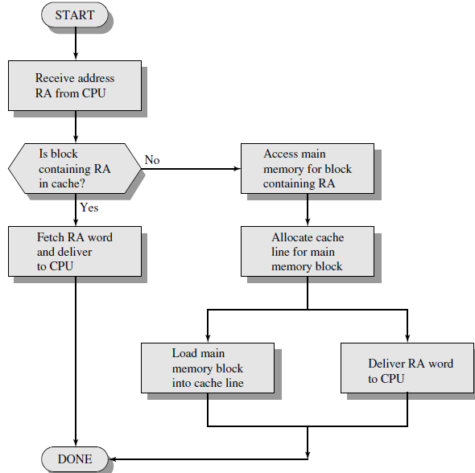
Cache Read Opera-tion

Slide 91
Performance metrics and improvements
Notes:
<number>

Slide 92
Cache Performance Metrics
Cache miss rate: number of cache misses divided by number of accesses
Cache hit time: the time between sending address and data returning from cache
Cache miss latency: the time between sending address and data returning from next-level cache/memory
Cache miss penalty: the extra processor stall caused by next-level cache/memory access

Slide 93
Two-Level Memory Operation
The upper-level memory (M1) is smaller, faster, and more expensive (per bit) than the lower-level memory (M2).
M1 is used as a temporary store for part of the contents of the larger M2.
When a memory reference is made, an attempt is made to access the item in M1. If this succeeds(hit), then a quick access is made.
If not (miss), then a block of memory locations is copied from M2 to M1 and the access then takes place via M1.
Because of locality, once a block is brought into M1, there should be a number of accesses to locations in that block, resulting in fast overall service.

Slide 94
Average Memory Access Time
To express the average time to access an item, we must consider not only the speeds of the two levels of memory, but also the probability that a given reference can be found in M1.
Ts = H * T1 + (1 - H) * (T1 + T2)
where,
Ts average (system) access time
T1 access time of M1 (e.g., cache, disk cache)
T2 access time of M2 (e.g., main memory, disk)
H hit ratio (fraction of time reference is found in M1

Slide 95

Performance Parameters for Two-Level Memory
Cost:
where,
Cs average cost per bit for the combined two-level memory
C1 average cost per bit of upper-level memory M1
C2 average cost per bit of lower-level memory M2
_{S1 size of M1}
_{S2 size of M2}
We would like Cs≈C2. Given that C1>>C2, this requires S1 <<S2.

Slide 96

Performance Parameters for Two-Level Memory(cont..)
Access time:
For a two-level memory to provide a significant performance improvement, we need to have Ts approximately equal to T1 (Ts ≈ T1). Given that T1 is much less than T2 (T1<< T2), a hit ratio of close to 1 is needed.
Access efficiency:- It is a measure of how close average access time (Ts) is to M1 access time (T1).

Slide 97
Performance Parameters for Two-Level Memory(cont..)
Typically, on-chip cache access time is about 25 to 50 times faster than main memory access time (i.e., T2/T1 is 5 to 10).
Off-chip cache access time is about 5 to 15 times faster than main memory access time (i.e., T2/T1 is 5 to 15),
Main memory access time is about 1000 times faster than disk access time (T2/T1 =1000).
If there is strong locality, it is possible to achieve high values of hit ratio even with relatively small upper-level memory size.
A cache in the range of 1K to 128K words is generally adequate, whereas main memory is now typically in the gigabyte range.

Slide 98
Performance of Cache
The performance of a cache (Hit Ratio) depends on:
Cache size
Cache block size
No. of cache levels
Cache mapping techniques
Cache replacement policies
Cache updation (write) policies

Slide 99
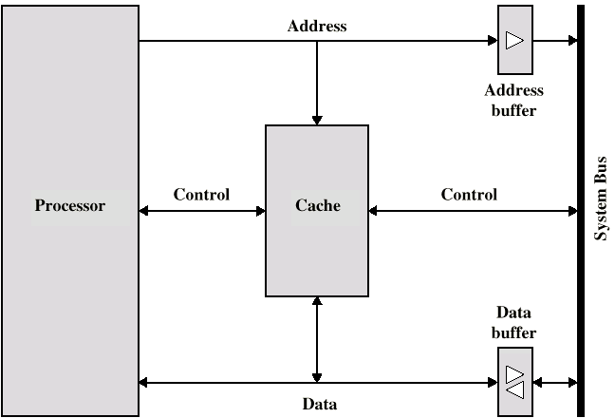
Size does matter
Cost
More cache is expensive
Speed
More cache is faster (up to a certain reasonable point)
Checking cache for data takes time
Typical cache
organization:
Notes:
<number>

Slide 100
Cache mapping techniques
Notes:
<number>

Slide 101
Mapping Function
Consider:
Cache of 64kByte
Each cache block is of 4 bytes
i.e. cache is 16k (2^{14) lines of 4 bytes}
^{16MBytes main memory}
^{24 bit address (224=16M)}
Thus, for mapping purposes, we can consider main memory to consist of 4M blocks of 4 bytes each.
Notes:
<number>

Slide 102
Direct Mapping
Each block of main memory maps to only one cache line
i.e. if a block is in cache, it must be in one specific place
The mapping is expressed as:
i = j modulo m
where, i= cache line number
j= main memory block number
m= number of lines in the cache
Address is in two parts:
Least Significant w bits identify unique word
Most Significant s bits specify one memory block
The MSBs are split into a cache line field r and a tag of s-r (most significant)
Notes:
<number>

Slide 103

Direct Mapping Address Structure
24 bit address
2 bit word identifier (4=2^{2 byte block)}
^{22 bit block identifier}
^{8 bit tag (=22-14)}
^{14 bit slot or line}
No two blocks in the same line have the same Tag field
Check contents of cache by finding line and checking Tag
Notes:
<number>

Slide 104
Direct Mapping Cache Line Table
Cache line Main Memory blocks held
0 0, m, 2m, 3m…2^{s-m}
^{1 1,m+1, 2m+1…2s-m+1}
^{m-1 m-1, 2m-1,3m-1…2s-1}
Notes:
<number>

Slide 105
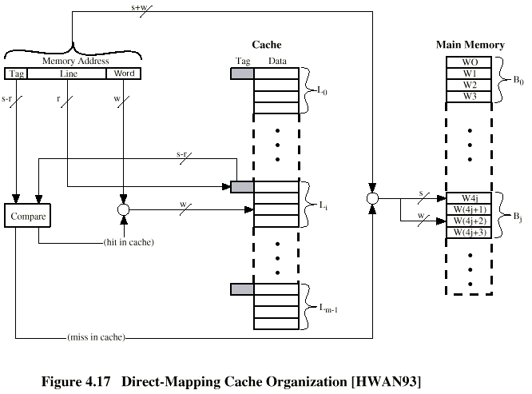
Direct Mapping Cache Organization
Notes:
<number>

Slide 106
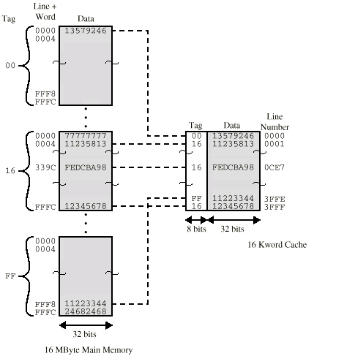
Direct Mapping Example
Notes:
<number>

Slide 107
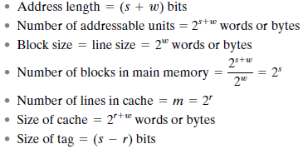
Direct Mapping Summary

Slide 108
Direct Mapping pros & cons
Simple
Inexpensive
Fixed location for given block
If a program accesses 2 blocks that map to the same line repeatedly, cache misses are very high
Hit ratio is very less
The maximum number of tag comparisons=1 as all tags are compared simultaneously
Notes:
<number>

Slide 109
Associative Mapping
A main memory block can load into any line of cache
Memory address is interpreted as tag + word
Tag uniquely identifies block of memory
Every line’s tag is sequentially examined for a match
The maximum number of tag comparisons =number of lines in a cache i.e. ‘m’.
The complexity of comparison hardware is more.
Cache searching gets expensive
The replacement is done only when the cache is full.
Hit ratio is very high.
Notes:
<number>

Slide 110
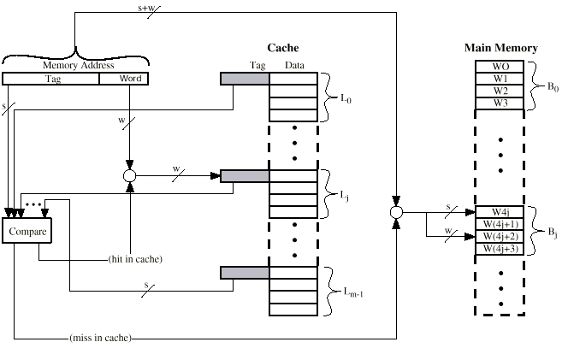
Fully Associative Cache Organization
Notes:
<number>

Slide 111
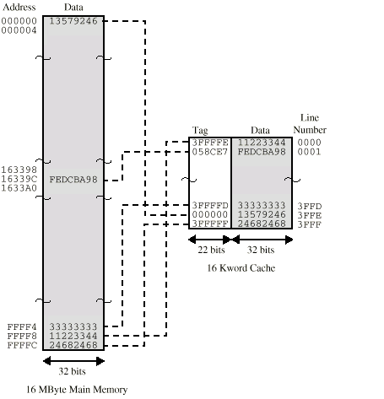
Associative Mapping Example
Notes:
<number>

Slide 112

Associative Mapping Address Structure
22 bit tag stored with each 32 bit block of data
Compare tag field with tag entry in cache to check for hit
Least significant 2 bits of address identify which 16 bit word is required from 32 bit data block
e.g.
Address Tag Data Cache line
FFFFFC FFFFFC 24682468 3FFF
Notes:
<number>

Slide 113
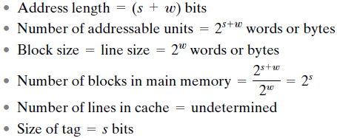
Associative Mapping Summary

Slide 114
Set Associative Mapping
It exhibits the strengths of both the direct and associative approaches while reducing their disadvantages.
Cache is divided into a number of sets
Each set contains a number of lines
A given block maps to any line in a given set
e.g. Block B can be in any line of set i
e.g. 2 lines per set
2 way associative mapping
A given block can be in one of 2 lines in only one set
Notes:
<number>

Slide 115
Set Associative Mapping (cont..)
The relationships are
m=v x k
i=j modulo v
where
i = cache set number
j = main memory block number
m = number of lines in the cache
v= number of sets
k= number of lines in each set
This is referred to as k-way set-associative mapping.
With this mapping, block Bj can be mapped into any of the lines of set j.

Slide 116
Set Associative Mapping (cont..)
The maximum number of tag comparisons =number of number of lines in each set i.e. ‘k’ (set size).
The complexity of comparison hardware is lesser than associative mapping.
But as set size, k, increases , tag length increases & hence complexity/cost of comparison hardware increases.
The replacement is done only when the set is full.
Hit ratio is optimal.

Slide 117
Set Associative Mapping Example
13 bit set number
Block number in main memory is modulo 2¹³
000000, 00A000, 00B000, 00C000 … map to same set
Notes:
<number>

Slide 118
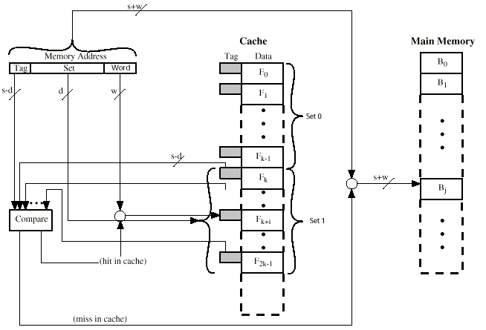
Two Way Set Associative Cache Organization
Notes:
<number>

Slide 119

Set Associative Mapping Address Structure
The cache control logic interprets a memory address as three fields: Tag + Set + Word.
Use set field to determine cache set to look in
Compare tag field to see if we have a hit
e.g.
Address Tag Data Set number
1FF 7FFC 1FF 12345678 1FFF
001 7FFC 001 11223344 1FFF
Notes:
<number>

Slide 120
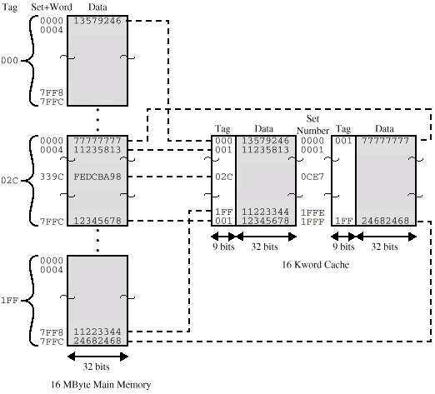
Two Way Set Associative Mapping Example
Notes:
<number>

Slide 121
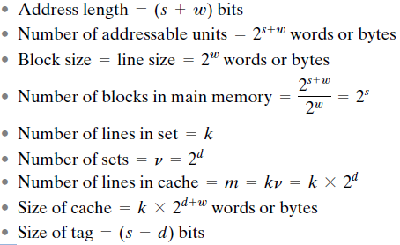
Set Associative Mapping Summary

Slide 122
Cache Replacement algorithms
Notes:
<number>

Slide 123
Replacement Algorithms
For Direct mapping
No choice
Each block only maps to one line
Replace that line
For Associative & Set Associative mapping
Hardware implemented algorithm (speed)
Least Recently used (LRU)
First in first out (FIFO)
Least frequently used(LFU)
Random
Notes:
<number>

Slide 124
Least Recently used (LRU)
Replace that block in the set that has been in the cache longest with no reference to it.
This is easily implemented using USE bit.
Each line includes a USE bit. When a line is referenced, its USE bit is set to 1 and the USE bit of the other line in that set is set to 0.
LRU should give the best hit ratio as we assume that more recently used memory locations are more likely to be referenced.
Notes:
<number>

Slide 125
Least Recently used (LRU) (cont..)
Relatively easy to implement for a fully associative cache.
The cache mechanism maintains a separate list of indices to all the lines in the cache.
When a line is referenced, it moves to the front of the list. For replacement, the line at the back of the list is used.
Because of its simplicity of implementation, LRU is the most popular replacement algorithm.

Slide 126
Replacement Algorithms (cont..)
First in first out (FIFO)
replace block that has been in cache longest
FIFO is easily implemented as a round-robin or circular buffer technique.
Least frequently used
replace the block that has experienced the fewest references.
LFU could be implemented by associating a counter with each line.
Random
not based on usage
Technique is to pick a line at random from among the candidate lines.

Slide 127
Write Policy
Must not overwrite a cache block unless main memory is up to date
Two cases:
If the old block in the cache has not been altered, then it may be overwritten with a new block without first writing out the old block.
If at least one write operation has been performed on a word in that line of the cache, then main memory must be updated by writing the line of cache out to the block of memory before bringing in the new block.
Notes:
<number>

Slide 128
Write Policy (cont..)
Major Problems:
Multiple CPUs may have individual local caches:
If a word is altered in one cache, it could conceivably invalidate a word in other caches.
I/O may address main memory directly:
If a word has been altered only in the cache, then the corresponding memory word is invalid.
If the I/O device has altered main memory, then the cache word is invalid.
Different WRITE policies:
Write Through
Write Back

Slide 129
Write through
All writes go to main memory as well as cache
Multiple CPUs can monitor main memory traffic to keep local (to CPU) cache up to date
Drawbacks:
Lots of traffic
Slows down writes
Notes:
<number>

Slide 130
Write back
Updates are initially made in cache only
When an update occurs, a dirty bit or use bit, associated with the line is set.
If block is to be replaced, write to main memory only if update bit is set
It minimizes memory writes.
Major Problem:
I/O must access main memory through cache
This makes for complex circuitry and a potential bottleneck.
Note :15% of memory references are writes
Notes:
<number>

Slide 131
multilevel caches
Notes:
<number>

Slide 132
Multilevel Caches
As logic density has increased it has become possible to have a cache on the same chip as the processor.
The on-chip cache reduces the processor’s external bus activity and speeds up execution time and increases overall system performance.
When the requested instruction or data is found in the on-chip cache, the bus access is eliminated
On-chip cache accesses will complete appreciably faster than would even zero-wait state bus cycles
During this period the bus is free to support other transfers
Two-level cache:
Internal cache designated as level 1 (L1)
External cache designated as level 2 (L2)
Potential savings due to the use of an L2 cache depends on the hit rates in both the L1 and L2 caches
The use of multilevel caches complicates all of the design issues related to caches, including size, replacement algorithm, and write policy.
Notes:
<number>

Slide 133
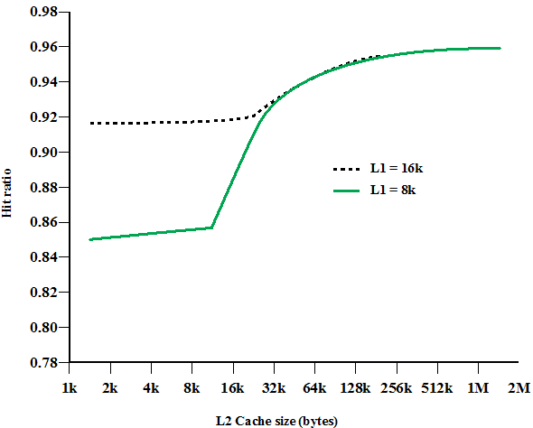
Multilevel Caches (cont..)

Slide 134
Split Vs Unified Caches
Has become common to split cache:
One dedicated to instructions
One dedicated to data
Both exist at the same level, typically as two L1 caches
Trend is toward split caches at the L1 and unified caches for higher levels
Advantages of split cache:
Eliminates cache contention between instruction fetch/decode unit and execution unit
Important in pipelining
Advantages of unified cache:
Higher hit rate
Balances load of instruction and data fetches automatically
Only one cache needs to be designed and implemented
Notes:
When the on-chip cache first made an appearance,
many of the designs consisted of a single cache used to store references to both data
and instructions. More recently, it has become common to split the cache into two:
one dedicated to instructions and one dedicated to data. These two caches both exist
at the same level, typically as two L1 caches. When the processor attempts to fetch an
instruction from main memory, it first consults the instruction L1 cache, and when the
processor attempts to fetch data from main memory, it first consults the data L1 cache.
There are two potential advantages of a unified cache:
• For a given cache size, a unified cache has a higher hit rate than split caches
because it balances the load between instruction and data fetches automatically.
That is, if an execution pattern involves many more instruction fetches
than data fetches, then the cache will tend to fill up with instructions, and if an
execution pattern involves relatively more data fetches, the opposite will occur.
• Only one cache needs to be designed and implemented.
The trend is toward split caches at the L1 and unified caches for higher levels,
particularly for superscalar machines, which emphasize parallel instruction execution
and the prefetching of predicted future instructions. The key advantage of the
split cache design is that it eliminates contention for the cache between the instruction
fetch/decode unit and the execution unit. This is important in any design that
relies on the pipelining of instructions. Typically, the processor will fetch instructions
ahead of time and fill a buffer, or pipeline, with instructions to be executed. Suppose
now that we have a unified instruction/data cache. When the execution unit performs
a memory access to load and store data, the request is submitted to the unified cache.
If, at the same time, the instruction prefetcher issues a read request to the cache for
an instruction, that request will be temporarily blocked so that the cache can service
the execution unit first, enabling it to complete the currently executing instruction.
This cache contention can degrade performance by interfering with efficient use of
the instruction pipeline. The split cache structure overcomes this difficulty.
<number>

Slide 135
cache coherence and mesi protocol
Notes:
<number>

Slide 136
Cache Coherency
When more than one device (typically a processor) shares a cache/ main memory a new problem arises:
If data in one cache are altered, this invalidates not only the corresponding word in main memory, but also that same word in other caches (if any other cache happens to have that same word).
Even if a write-through policy is used, the other caches may contain invalid data.
A system that prevents this problem is said to maintain cache coherency.

Slide 137
Cache Coherency (cont..)
Cache coherence problem: Multiple copies of the same data can exist in different caches simultaneously, and if processors are allowed to update their own copies freely, an inconsistent view of memory can result.
Write back policy can lead to inconsistency as main memory is only updated when the corresponding cache line is flushed from the cache.
Write through can also give problems unless caches monitor memory traffic.
Different approaches and different solutions.

Slide 138
Approaches to Cache Coherency
Bus watching with write through:
Each cache controller monitors the address lines to detect write operations to memory by other bus masters.
If another master writes to a location in shared memory that also resides in the cache memory, the cache controller invalidates that cache entry.
This strategy depends on the use of a write-through policy by all cache controllers.
Hardware transparency:
Additional hardware is used to ensure that all updates to main memory via cache are reflected in all caches.
Thus, if one processor modifies a word in its cache, this update is written to main memory and also in other caches containing the matching words .

Slide 139
Approaches to Cache Coherency (cont..)
Noncacheable memory:
Only a portion of main memory is shared by more than one processor, and this is designated as noncacheable.
In such a system, all accesses to shared memory are cache misses, because the shared memory is never copied into the cache.
The noncacheable memory can be identified using chip-select logic or high-address bits.

Slide 140
Software Solutions
Software Solutions:
Compiler and operating system deal with problem
Overhead transferred to compile time
Design complexity transferred from hardware to software
S/W tends to make conservative decisions
Inefficient cache utilization
Analyze code to determine safe periods for caching shared variables
Hardware Solutions(Cache coherence protocols):
Dynamic recognition of potential problems ,Run time
More efficient use of cache
Transparent to programmer
Two categories:-Directory protocols & Snoopy protocols
Notes:
<number>

Slide 141
Directory Protocols
Collect and maintain information about copies of data in cache
Directory stored in main memory
Requests are checked against directory
Appropriate transfers are performed
Creates central bottleneck
Effective in large scale systems with complex interconnection schemes
Notes:
<number>

Slide 142
Snoopy Protocols
Distribute cache coherence responsibility among cache controllers
Cache recognizes that a line is shared
Updates announced to other caches
Suited to bus based multiprocessor
Increases bus traffic
Two basic approaches:
Write Invalidate and Write Update (or write broadcast)
Neither of these two approaches is superior
Performance depends on the number of local caches and the pattern of memory reads and writes.
Adaptive protocols that employ both mechanisms.
Notes:
<number>

Slide 143
Write Invalidate
Multiple readers, one writer
When a write is required, all other caches of the line are invalidated
Writing processor then has exclusive (chip) access until line required by another processor
Used in Pentium II and PowerPC systems
State of every line is marked as modified, exclusive, shared or invalid
It is called MESI protocol (modified, exclusive, shared, or invalid)
As it uses 2 extra bits in the cache tag for identifying the line status as modified/ exclusive/ shared/invalid
Notes:
<number>

Slide 144
Write Update
Multiple readers and writers
When a processor wishes to update a shared line, the word to be updated is distributed to all others, and caches containing that line can update it.
Notes:
<number>

Slide 145
MESI Protocol
For MESI, the data cache includes two status bits per tag, so that each line can be in one of four states:
Modified: The line in the cache has been modified (different from main memory) and is available only in this cache.
Exclusive: The line in the cache is the same as that in main memory and is not present in any other cache.
Shared: The line in the cache is the same as that in main memory and may be present in another cache.
Invalid: The line in the cache does not contain valid data.

Slide 146
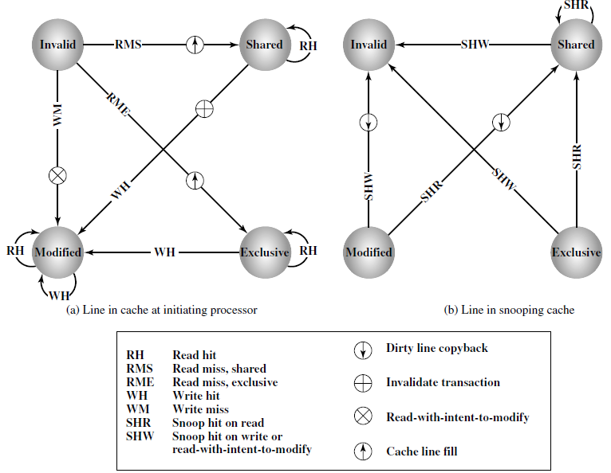
MESI State Transition Diagram

Slide 147
Memory SEGMENTATION
Notes:
<number>

Slide 148
Memory segmentation
It is the division of a computer's primary memory into segments or sections.
In segmentation, a reference to a memory location includes a value that identifies a segment and an offset within that segment.
Segments usually correspond to natural divisions of a program such as individual routines or data tables so segmentation is generally more visible to the programmer than paging alone.

Slide 149
Segmentation(cont..)
Different segments may be created for different program modules, or for different classes of memory usage such as code and data segments.
Certain segments may be shared between programs.
Segment table entries map virtual addresses to segment addresses, intermediate table addresses and page table addresses.

Slide 150
Segmentation (cont..)
Memory-management scheme that supports user view of memory
A program is a collection of segments. A segment is a logical unit such as:
main program,
procedure,
function,
method,
object,
local variables, global variables,
common block,
stack,
symbol table, arrays

Slide 151
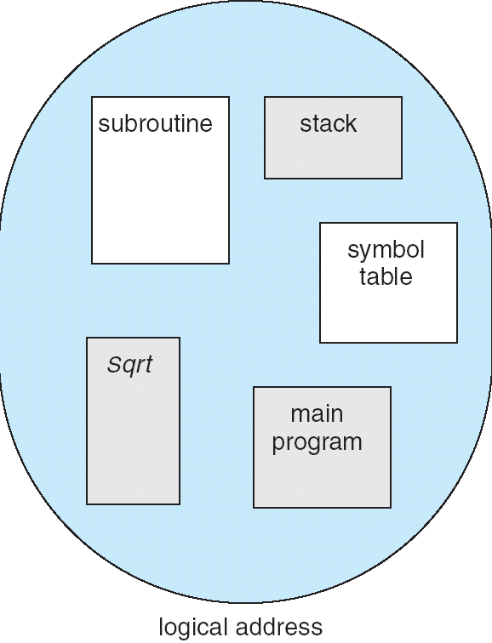
User’s View of a Program

Slide 152
Logical View of Segmentation
1
1
4
2
3
4
2
3
user space
physical memory space

Slide 153
Segmentation Architecture
Logical address consists of a two tuple:
<segment-number, offset>,
Segment table – maps two-dimensional physical addresses; each table entry has:
base – contains the starting physical address where the segments reside in memory
limit – specifies the length of the segment
Segment-table base register (STBR) points to the segment table’s location in memory
Segment-table length register (STLR) indicates number of segments used by a program;
segment number s is legal if s < STLR

Slide 154
Segmentation Architecture (cont..)
Protection
With each entry in segment table associate:
validation bit = 0 ⇒ illegal segment
read/write/execute privileges
Protection bits associated with segments; code sharing occurs at segment level
Since segments vary in length, memory allocation is a dynamic storage-allocation problem
A segmentation example is shown in the following diagram

Slide 155
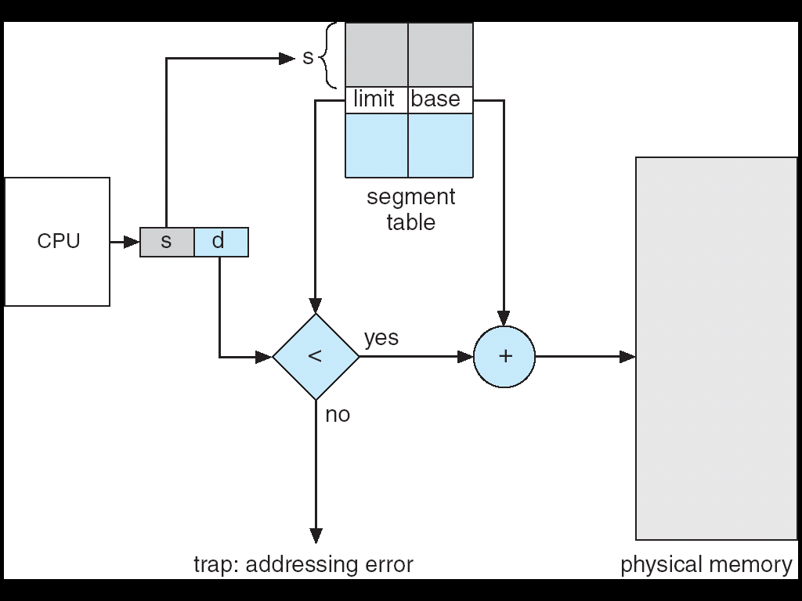
Segmentation Hardware

Slide 156
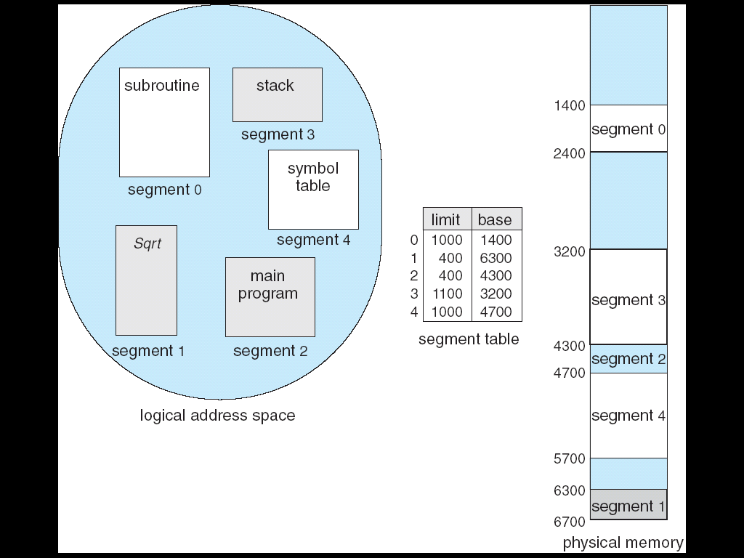
Example of Segmen-tation

Slide 157
interleaved Memory
Notes:
<number>

Slide 158
Interleaved Memory
Main memory is typically of a series of DRAM chips.
A number of these chips form a bank, with a port for transfer of data to and from the processor or an intermediate cache.
Multiple memory banks can be connected together to form an interleaved memory system.
Because each bank can service a request, an interleaved memory system with N banks can service N requests simultaneously, increasing the peak data transfer rate by a factor of N over the data transfer rate of a single bank.
Interleaved memory is more flexible than wide-access memory in that it can handle multiple independent accesses at once.

Slide 159
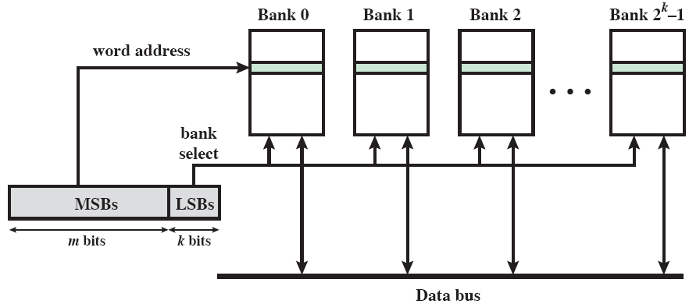
Interleaved Memory (cont..)
In most memory systems, the number of banks is a power of 2; that is, N= 2^{k for some integer k.}

Slide 160
Interleaved Memory (cont..)
Multiple memory banks are connected to a single bus (channel) and differentiated by the lower (least significant) k bits of the address bus.
They share the bus by time division and overlapping the operations.
If the address length is (m + k) bits, then the upper (most significant) m bits of the address select a word within a memory bank, while the lower k bits select the given memory bank.
The interleaved memory system is most effective when the number of memory banks is equal to or an integer multiple of the number of words in a cache line.

Slide 161
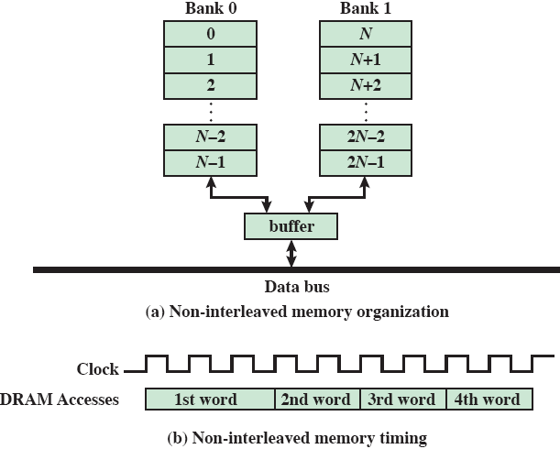
Example: Non-interleaved Memory Organization

Slide 162
Non-interleaved Memory Organization (cont..)
If the memory controller does not support interleaving, then the memory addresses are assigned sequentially in the first bank, followed by addresses in the second bank.
All the words in the block come from one bank of DRAM in a non-interleaved memory organization, so the time required to complete the transfer is a linear function of the number of words transferred.
Note that the time needed to transfer each of the second, third, and fourth words is shorter than the time for the first word. This is because of a feature of contemporary DRAMs known as page-mode access. This is, in effect, a form of on-chip caching on the DRAM chip.

Slide 163
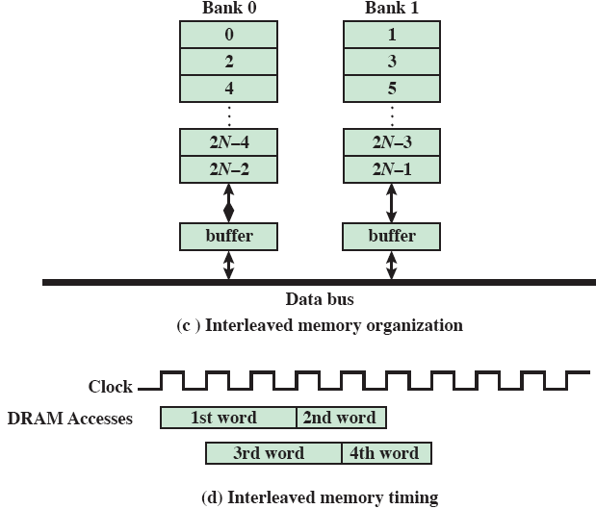
Example: Interleaved Memory Organization

Slide 164
Interleaved Memory Organization (cont..)
If the memory controller supports interleaved memory, then memory addresses alternate between the two banks.
This configuration speeds up the burst transfer of words.
The reason is that the words of a burst access are spread across two physical banks of DRAM, the individual accesses can be overlapped to hide part, or all, of the DRAM access time delay.

Slide 165
virtual Memory
Notes:
<number>

Slide 166
Main Memory Organization
Physical main memory is not as large as the address space spanned by an address issued by the processor.
2^{32 = 4 GB, 264 = …}
When a program does not completely fit into the main memory, the parts of it not currently being executed are stored on secondary storage devices.
Techniques that automatically move program and data blocks into the physical main memory when they are required for execution are called virtual-memory techniques.
Virtual addresses will be translated into physical addresses.
Notes:
<number>

Slide 167
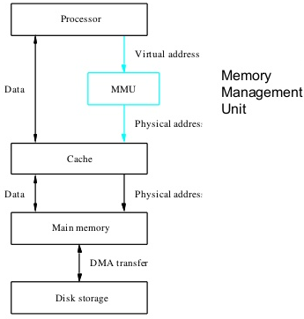
Virtual Memory Organization
Notes:
<number>

Slide 168
Memory-Management Unit (MMU)
The concept of a logical address space that is bound to a separate physical address space is central to proper memory management
Logical address – generated by the CPU; also referred to as virtual address
Physical address – address seen by the memory unit
MMU is a hardware device that maps virtual to physical address
In MMU scheme, the value in the relocation register is added to every address generated by a user process at the time it is sent to memory
The user program deals with logical addresses; it never sees the real physical addresses.

Slide 169
Paging
All programs and data are composed of fixed-length units called pages, each of which consists of a block of words that occupy contiguous locations in the main memory.
Page cannot be too small or too large.
Paging is one of the memory management schemes by which a computer stores and retrieves data from the secondary storage for use in main memory.
In the paging memory-management scheme, the operating system retrieves data from secondary storage in same-size blocks called pages.

Slide 170
Paging (cont..)
Logical address space of a process can be noncontiguous; process is allocated physical memory whenever the latter is available
Divide physical memory into fixed-sized blocks called frames (size is power of 2, between 512 bytes and 8,192 bytes)
Divide logical memory into blocks of same size called pages
Keep track of all free frames
To run a program of size n pages, need to find n free frames and load program
Set up a page table to translate logical to physical addresses

Slide 171

Address Translation Scheme
Address generated by CPU is divided into:
Page number (p) – used as an index into a page table which contains base address of each page in physical memory
Page offset (d) – combined with base address to define the physical memory address that is sent to the memory unit
For given logical address space 2^{m and page size 2n}

Slide 172
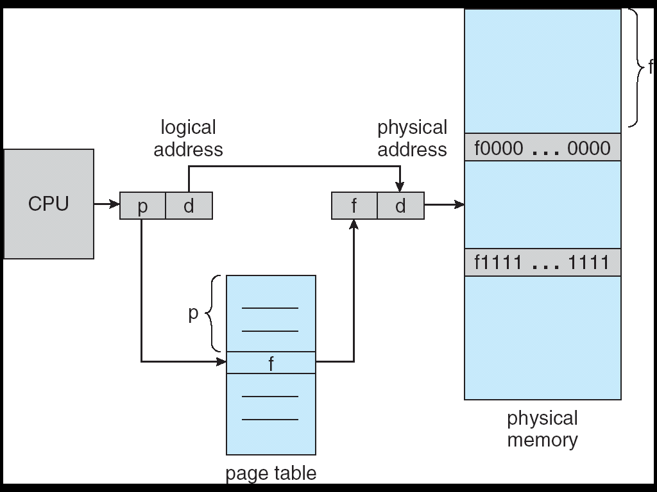
Paging Hardware

Slide 173
Implementation of Page Table
Page table is kept in main memory
Page-table base register (PTBR) points to the page table
Page-table length register (PTLR) indicates size of the page table
In this scheme every data/instruction access requires two memory accesses. One for the page table and one for the data/instruction.
The two memory access problem can be solved by the use of a special fast-lookup hardware cache called associative memory or translation look-aside buffers (TLBs)
Some TLBs store address-space identifiers (ASIDs) in each TLB entry – uniquely identifies each process to provide address-space protection for that process

Slide 174
Associative Memory
Associative memory – parallel search
Address translation (p, d)
If p is in associative register, get frame # out
Otherwise get frame # from page table in memory
Page #
Frame #

Slide 175
Address Translation
The virtual memory mechanism bridges the size and speed gaps between the main memory and secondary storage – similar to cache.
Notes:
<number>

Slide 176
Page Tables and Address Translation
The role of page table in the virtual-to-physical address translation process.

Slide 177
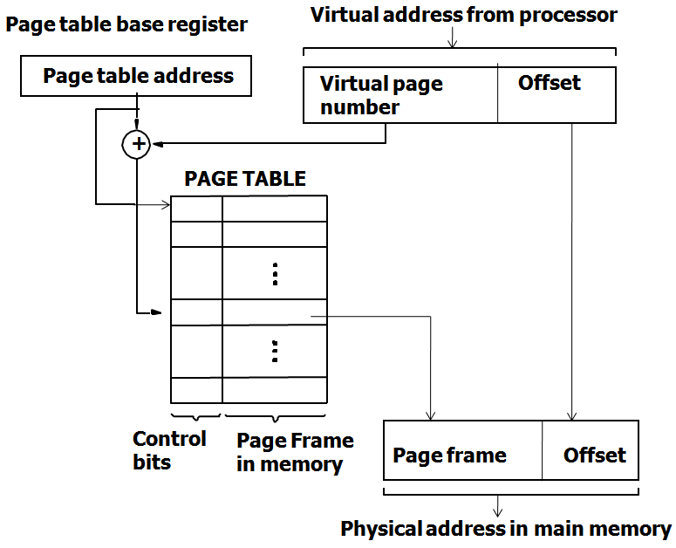
Virtual Memory Address Trans-lation

Slide 178
Address Translation
The page table information is used by the MMU for every access, so it is supposed to be with the MMU.
However, since MMU is on the processor chip & the page table is rather large, only small portion of it, which consists of the page table entries that correspond to the most recently accessed pages, can be accommodated within the MMU.
Translation Look-aside Buffer (TLB):
It is a memory management hardware uses to improve virtual address translation speed.
It has a fixed number of slots containing page table entries and segment table entries;
Page table entries map virtual addresses to physical addresses and intermediate table addresses,
Notes:
<number>

Slide 179
TLB
The contents of TLB must be coherent with the contents of page tables in the memory.
Translation procedure.
Page fault
Page replacement
Write-through is not suitable for virtual memory.
Locality of reference in virtual memory
Notes:
<number>

Slide 180

Paging Hardware With TLB

Slide 181
Input-output systems
Notes:
<number>

Slide 182
Input/Output Problems
Wide variety of peripherals
Delivering different amounts of data
At different speeds
In different formats
All slower than CPU and RAM
Need I/O modules
Interface to CPU and Memory
Interface to one or more peripherals
Notes:
<number>

Slide 183

Generic Model of I/O Module

Slide 184

External Devices
Human readable- Screen, printer, keyboard
Machine readable- Monitoring and control
Communication-Modem, Network Interface Card (NIC)
External Device
Block Diagram
Notes:
<number>

Slide 185

Typical I/O Data Rates

Slide 186
I/O Module Function
Control & Timing
CPU Communication
Device Communication
Data Buffering
Error Detection
I/O Steps:
CPU checks I/O module device status
I/O module returns status
If ready, CPU requests data transfer
I/O module gets data from device
I/O module transfers data to CPU
Variations for output, DMA, etc.
Notes:
<number>

Slide 187

I/O Module Diagram
Notes:
<number>

Slide 188
Input-output techniques
Notes:
<number>

Slide 189
Input Output Techniques
Programmed
Interrupt driven
Direct Memory Access (DMA)
Notes:
<number>

Slide 190
Programmed I/O
CPU has direct control over I/O
Sensing status
Read/write commands
Transferring data
CPU waits for I/O module to complete operation
Wastes CPU time
Addressing I/O Devices
Under programmed I/O data transfer is very like memory access (CPU viewpoint)
Each device given unique identifier
CPU commands contain identifier (address)
Notes:
<number>

Slide 191
Accessing I/O Devices: I/O Mapping
Memory mapped I/O
Devices and memory share an address space
I/O looks just like memory read/write
No special commands for I/O
Large selection of memory access commands available
Isolated I/O
Separate address spaces
Need I/O or memory select lines
Special commands for I/O
Limited set
Notes:
<number>

Slide 192

Memory Mapped and Isolated I/O

Slide 193
Programmed I/O - Basic Operation
CPU requests I/O operation
I/O module performs operation
I/O module sets status bits
CPU checks status bits periodically
I/O module does not inform CPU directly
I/O module does not interrupt CPU
CPU may wait or come back later
Notes:
<number>

Slide 194
Interrupt Driven I/O
Overcomes CPU waiting
No repeated CPU checking of device
I/O module interrupts when ready
Notes:
<number>

Slide 195
Interrupt Driven I/O- Basic Operation
CPU issues read command
I/O module gets data from peripheral whilst CPU does other work
I/O module interrupts CPU
CPU requests data
I/O module transfers data
Notes:
<number>

Slide 196

Simple Interrupt Processing

Slide 197
CPU Viewpoint
Issue read command
Do other work
Check for interrupt at end of each instruction cycle
If interrupted:-
Save context (registers)
Process interrupt
Fetch data & store
Notes:
<number>

Slide 198
Design Issues
How do you identify the module issuing the interrupt?
How do you deal with multiple interrupts?
i.e. an interrupt handler being interrupted
Multiple Interrupts
Each interrupt line has a priority
Higher priority lines can interrupt lower priority lines
If bus mastering only current master can interrupt
Example- PC Bus
80x86 has one interrupt line
8086 based systems use one 8259A interrupt controller
8259A has 8 interrupt lines
Notes:
<number>

Slide 199
Identifying Interrupting Module (1)
Different line for each module
PC
Limits number of devices
Software poll
CPU asks each module in turn
Slow
Notes:
<number>

Slide 200
Identifying Interrupting Module (2)
Daisy Chain or Hardware poll
Interrupt Acknowledge sent down a chain
Module responsible places vector on bus
CPU uses vector to identify handler routine
Bus Master
Module must claim the bus before it can raise interrupt
e.g. PCI & SCSI
Notes:
<number>

Slide 201
Direct Memory access
Notes:
<number>

Slide 202
Direct Memory Access
Interrupt driven and programmed I/O require active CPU intervention
Transfer rate is limited
CPU is tied up
DMA is the answer
DMA Function:
Additional Module (hardware) on bus
DMA controller takes over from CPU for I/O
Notes:
<number>

Slide 203
Direct Memory Access(cont..)
Direct memory access (DMA) is a process in which an external device takes over the control of system bus from the CPU.
DMA is for high-speed data transfer from/to mass storage peripherals, e.g. hard disk drive, magnetic tape, CD-ROM, and sometimes video controllers.
The basic idea of DMA is to transfer blocks of data directly between memory and peripherals.
The data don’t go through the microprocessor but the data bus is occupied.

Slide 204

DMA Module Diagram

Slide 205
DMA Operation
CPU tells DMA controller:-
Read/Write
Device address
Starting address of memory block for data
Amount of data to be transferred
CPU carries on with other work
DMA controller deals with transfer
DMA controller sends interrupt when finished
Notes:
<number>

Slide 206
DMA Transfer Cycle Stealing
DMA controller takes over bus for a cycle
Transfer of one word of data
Not an interrupt
CPU does not switch context
CPU suspended just before it accesses bus
i.e. before an operand or data fetch or a data write
Slows down CPU but not as much as CPU doing transfer
Notes:
<number>

